Slide 1

ECE411 - Practicum T05 – Electronic Compass
Cody Gabriel
Benjamin Huntsman
John Maseda
Michael Walton
12/13/2013

Slide 2
Needs
Land Navigation Human Calibration
Robot needs compass input
Project required for Practicum

Slide 3
Motivation
The value is in the USB interface for Robot
Alternative compass solutions are analog or phone based with the primary user being Human.
Provides something that was not accessible at relatively low cost before.

Slide 4
Objective
Our objective is design, build, and test a working digital compass prototype.
The design will incorporate:
8-bit microcontroller as a processing unit
magnetometer as an input sensor
an LCD display as an output

Slide 5
Alternatives
There are no COTS alternatives for the Robotic compass that are financially feasible.
Many modern alternatives exist for basic land navigation.
Analog compass
Smartphone apps
Handheld GPS devices

Slide 6
Requirements (Course)
Have one or more inputs or sensors
Have one or more outputs or transducers
Have one or more processing module
Use a 2-layer PCB
Use components that can be hand soldered or easily soldered in a crude reflow oven

Slide 7
Requirements (Engineering)
Be accurate to within 5° of true orientation
Have a switch to power on the device and be ready within a short period of time
Output on a display a heading either with a compass face or with letters (i.e. “NNW”) as well as a numerical value in degrees
Be prepared for software updates
Display must have a backlight for use in the dark

Slide 8
Approach: Project Selection
A list of four possible projects were considered:
Electronic Compass
Bicycle brake light/blinker system
Ironman Repulsor Weapon
Homemade oscilloscope

Slide 9
Approach: Initial Design
Major components selection
μC: ATmega32u4
Magnetometer/Accelerometer: LSM303DLH
LCD: Nokia 5110
PMIC: LTC4067
Research major components; understanding setup and operation
Order development boards from SparkFun for initial prototyping
Defining project requirements

Slide 10
Approach: Schematic, Layout, & IDE
Application notes for the major components were considered
Decided to only implement μC and PMIC on manufactured board; LCD and magnetometer dev-boards connected via header pins
EAGLE CAD software used for schematic and layout
AVRdude for coding

Slide 11
Approach: Construction
The board layout was sent to OSH Park for fabrication using their design rules
Two of our major components, Atmega32u4 and LTC4067 came in packages that were not hand solder-able
The ATmega32u4 chip that we used came in a QFN package, and the LTC4067 was in a DFN package
Due to the components that could not be soldered by hand, the reflow oven in the EPL was used for construction

Slide 12
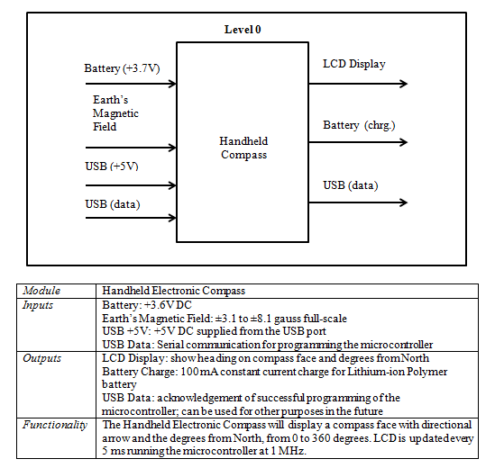
Design: System level 0

Slide 13
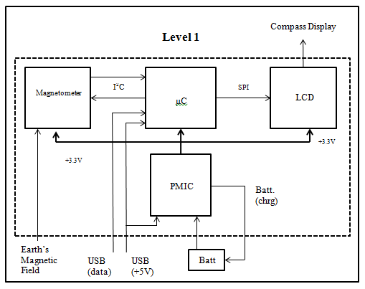
Design: level 1

Slide 14
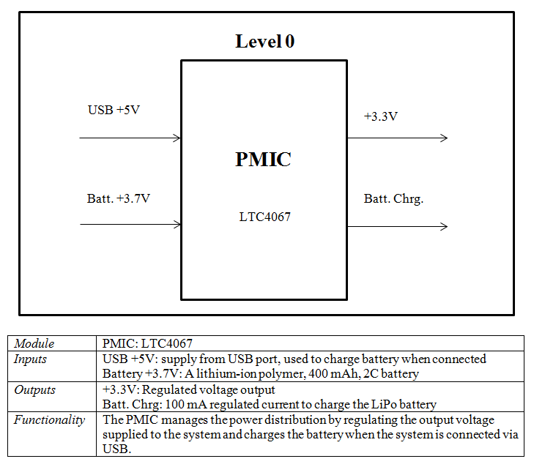
Design: Power Management

Slide 15
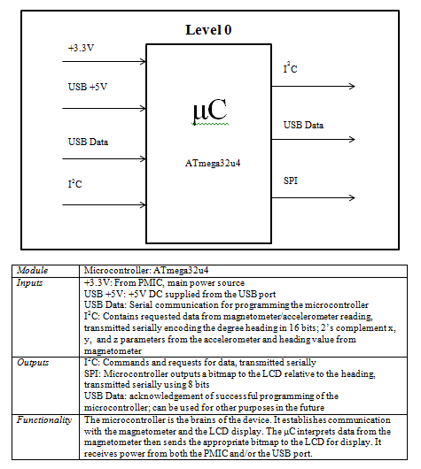
Design: Microcontroller

Slide 16
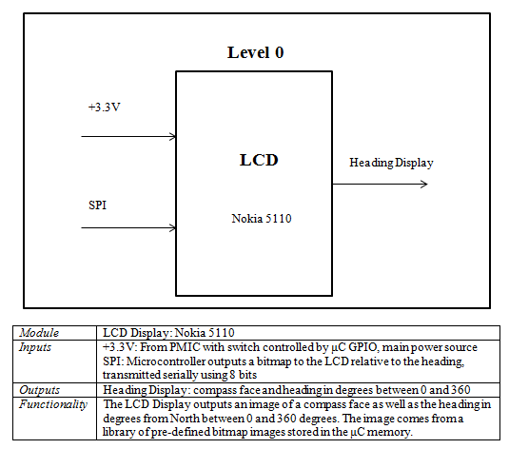
Design: LCD

Slide 17
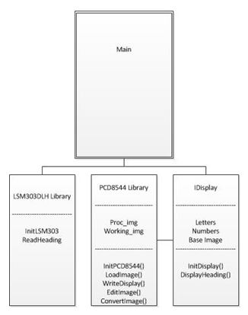
Design: Coding

Slide 18
Implementation
Board Layout: Eagle CAD Implemented
Pin 1 Convention top left
Caps as close as possible to ICs
μC centered for space management
Large power lines
Signal Lines Rx, Tx same length
LCD header centric
Test points and vias for all GPIOs (modifiable)
Magnetometer headers “Isolated” from noise

Slide 19
IP/Prior Work
We utilized the LCD and Magnetometer Development Boards.
Implementing these COTS Items cost an extra $10 per board, and added design, and implementation constraints.
Saving the time and effort of integrating these components.

Slide 20
Testing
PMIC:
Use implemented test points for appropriate DC values
Charge a battery and test its voltage ensuring that PMIC stops charging at correct voltage
Check supply voltages to daughterboards
Microcontroller:
Connect via USB
GPIO’s used for switching power on to LCD and sensor easily verified using a multimeter
Calibration verified using known working compass

Slide 21
Testing
LCD:
Check DC inputs
View data signals with MSO through test points
Visually verify text output
Magnetometer/Accelerometer
Check DC inputs
View data signals with MSO through test points
Verify output by comparison of values on LCD to known working compass

Slide 22
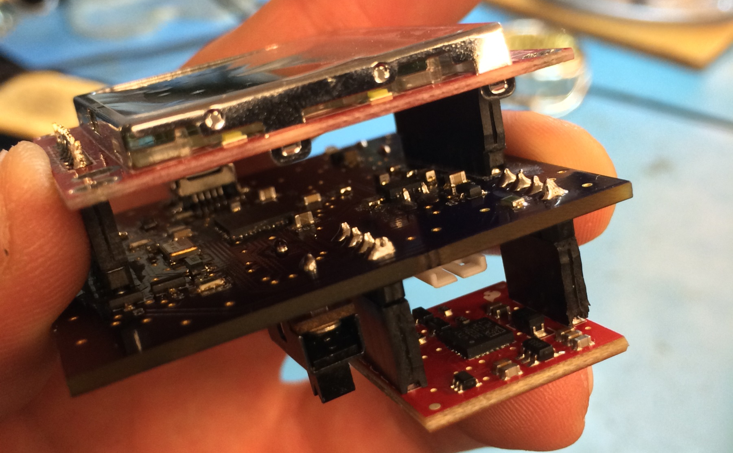
Results

Slide 23
Ben’s Contributions
Layout: initial header placement and stack design, pin breakout for sensor and LCD
Schematic Design: Updating/Organizing for aesthetics
LCD: parts selection, coding
Test: LCD
Documentation: contributor

Slide 24
Michael’s Contributions
Schematic Design: Selection of magnetometer/accelerometer
Implementation: Sensor coding, calibration and use verification
Test: sensor testing
Documentation: contributor

Slide 25
John’s Contributions
Schematic Design: Initial layout, editing, revising, updating.
Layout: stack design, part placement, layer design, routing, organization, revising updating.
Implementation: oven soldering, hand soldering, assembly
Testing: Isolation and continuity testing, Signal testing
Documentation: Presentation pieces, wprs
Deliverables: OSHpark design files, most of layout DWG, part of circuit SCH

Slide 26
Cody’s Contributions
Initial Design: PMIC selection
Schematic: adhered to application notes for USB battery charging and μC busses, designed GPIO enabled transistor switches, minor parts selection
Parts order and tracking
Major contributor to group homework assignments and documentation
Testing: Modular troubleshooting, DC power supply verification, header pin modification

Slide 27
Ben’s Lessons Learned
Check each others work
Check outputs of each device for correctness before connecting to eachother
Don’t feature creep yourself

Slide 28
Michael’s Lessons Learned
Verify manufacturer supplied code before trying to implement
Verify teammates work

Slide 29
John’s Lessons Learned
Getting started early sets up the team for success.
Problems will occur preparing for them is possible, when surprised grace is required .
Eagle Cad is a good free program.
Bulk board orders are cheaper.
The EPL is an awesome but very small place to build a board.
Having a good rout plan before you start the layout saves time and rework effort.

Slide 30
Cody’s Lessons Learned
Professional grade design and construction
Constant communication is key to success
Step up when the team needs you to
Verify all parts are ordered more than once
Don’t be complacent!

Slide 31

The end

